Slide 1

Global University Ranking Analysis
Presented by
Group 26
B01759301
B01757368
B01772768
B01746656
B01764963
B01755979
B01794675

Slide 2
Overview
Dataset: Times Higher Education World University Rankings
Tools: Tableau, Tableau Prep and Microsoft Excel
Key Areas of Interest
Total score
Teaching
Research
International student diversity
Student population

Slide 3
Key Insights
USA dominates global rankings with 11 out of top 15 universities.
Caltech, Stanford, and Harvard have the highest total scores.
Singapore, USA, and Canada have the best average university scores.
UK is consistent in teaching and research; USA is top but scattered.
Swiss and UK universities lead in international student percentages.
USA has the highest number of ranked universities (327).

Slide 4
Dashboard Design
Top 15 Universities by Total Score (Bar Chart): Highlights top-performing global institutions.
Average Total Score by Country (Bar Chart): Shows academic quality at the national level.
Teaching vs Research (Scatter Plot): Reveals performance consistency and balance.
Top 15 by International Students (Bar Chart): Indicates diversity and global appeal.

Slide 5
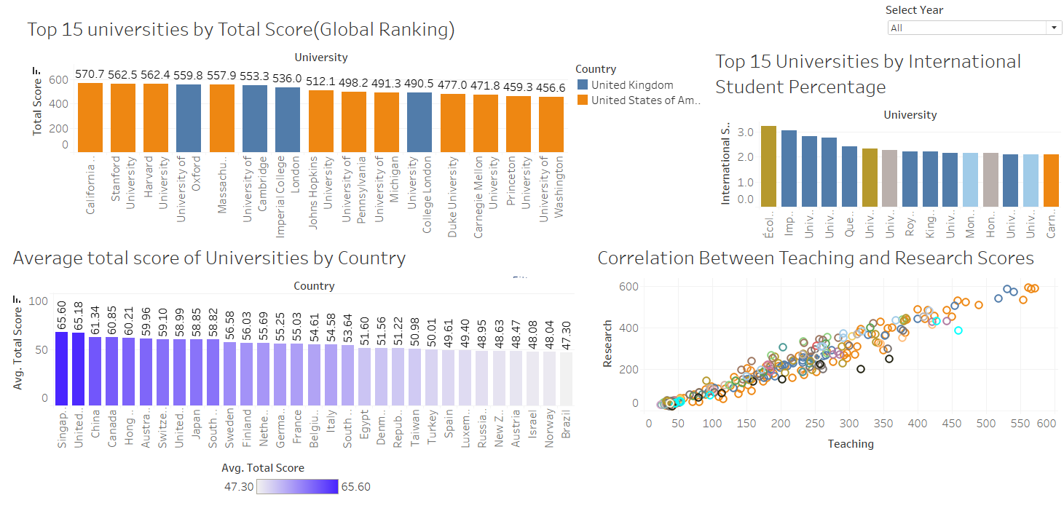
Demonstration

Slide 6
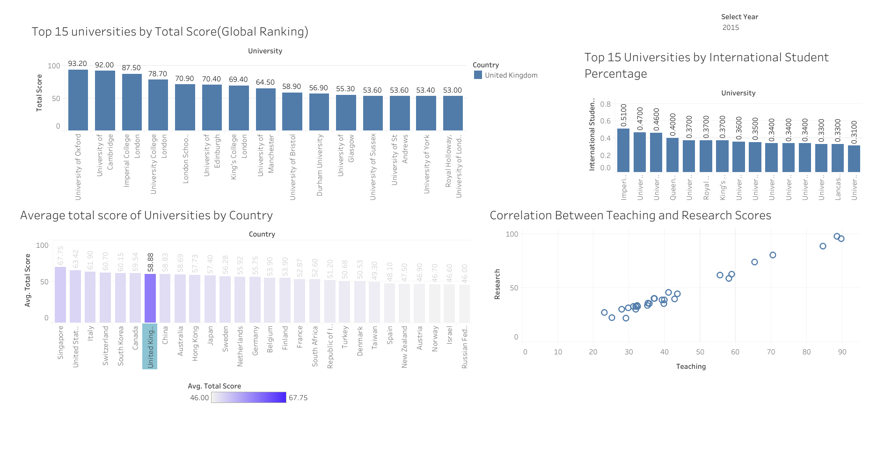
United Kingdom in the year 2015

Slide 7
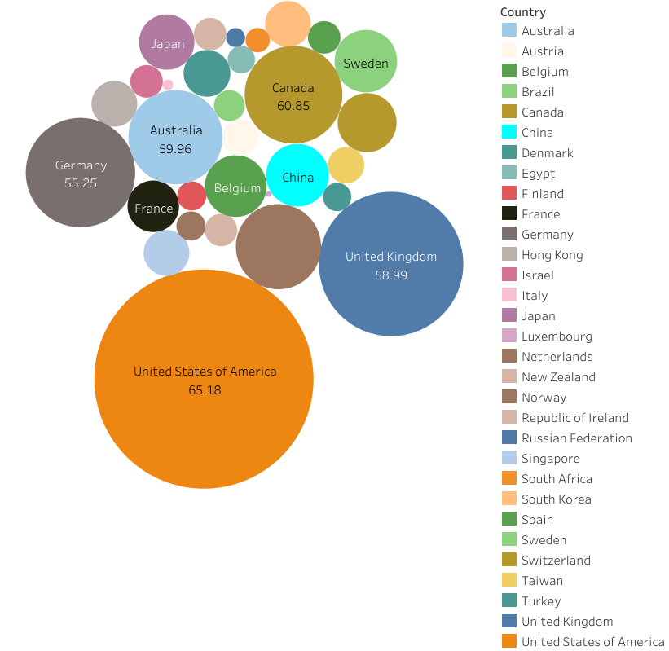
Average Score/Student Population by Country

Slide 8
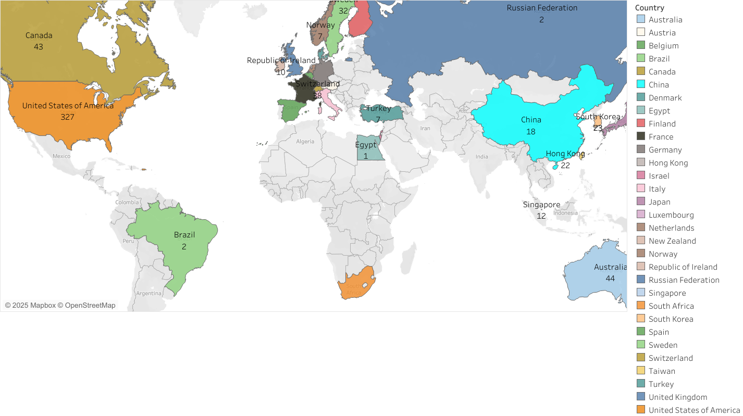
Global Distribution

Slide 9
Conclusion
USA leads with most top-ranked universities and highest student population.
Singapore ranks highest in average university score.
UK shows strong consistency in teaching, research, and international diversity.
Teaching and research scores are closely linked in top institutions.
Data reveals clear global patterns in academic quality and diversity.

